Slide 1
SmartJob - A Dynamic Job Board Application
Project Group Number: 9
Anirudh Maheshwari
Anuj Yogesh Sharma
Nilraj Mayekar
Rohith Varma Datla
Bhuvan Dama Venkatesh Raj

Slide 2


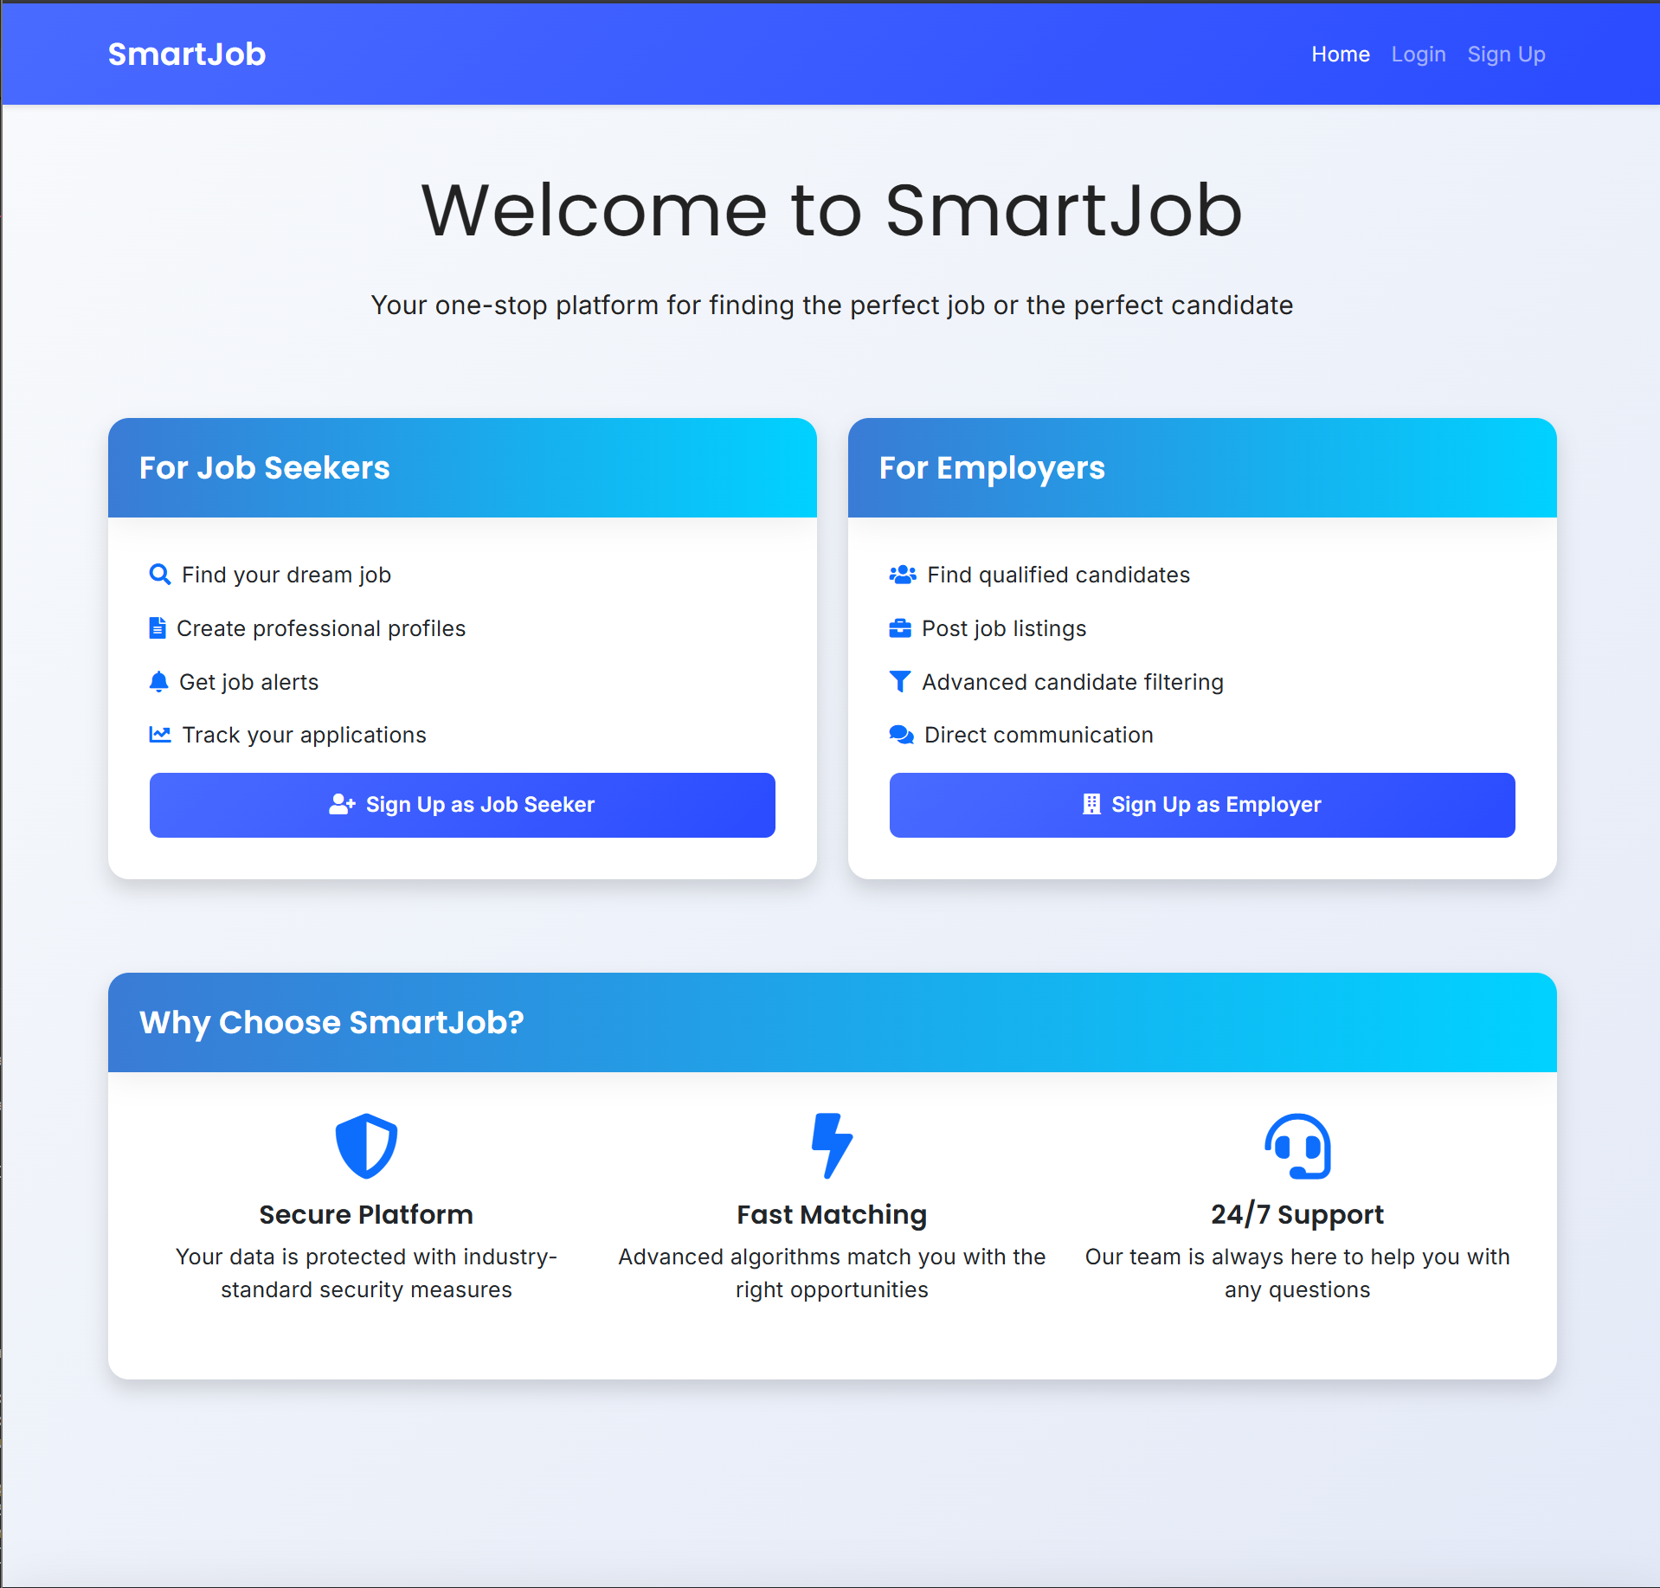
SmartJob
Technologies Used
Backend: Spring Boot, Java
Frontend: HTML, CSS, JavaScript, Thymeleaf, Bootstrap 5
Data Access: Spring Data JPA
Database: MYSQL hosted on AIVEN
Security: Basic authentication and session management
Email: Mailgun API integration
Repository Link https://github.com/anujy787/smart-job

Slide 3
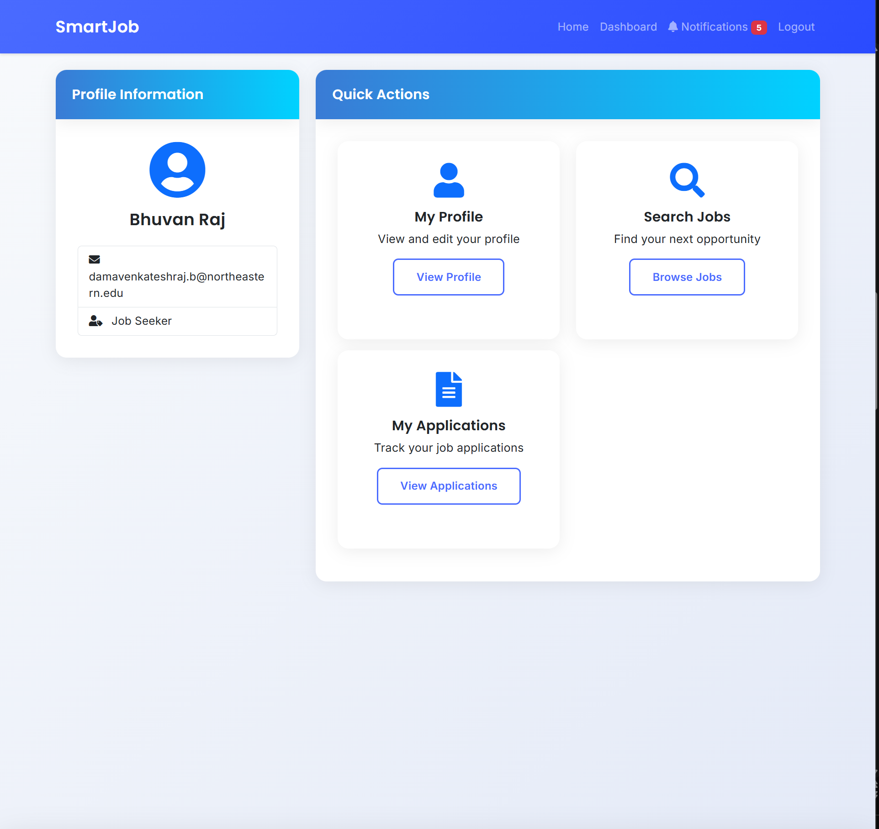
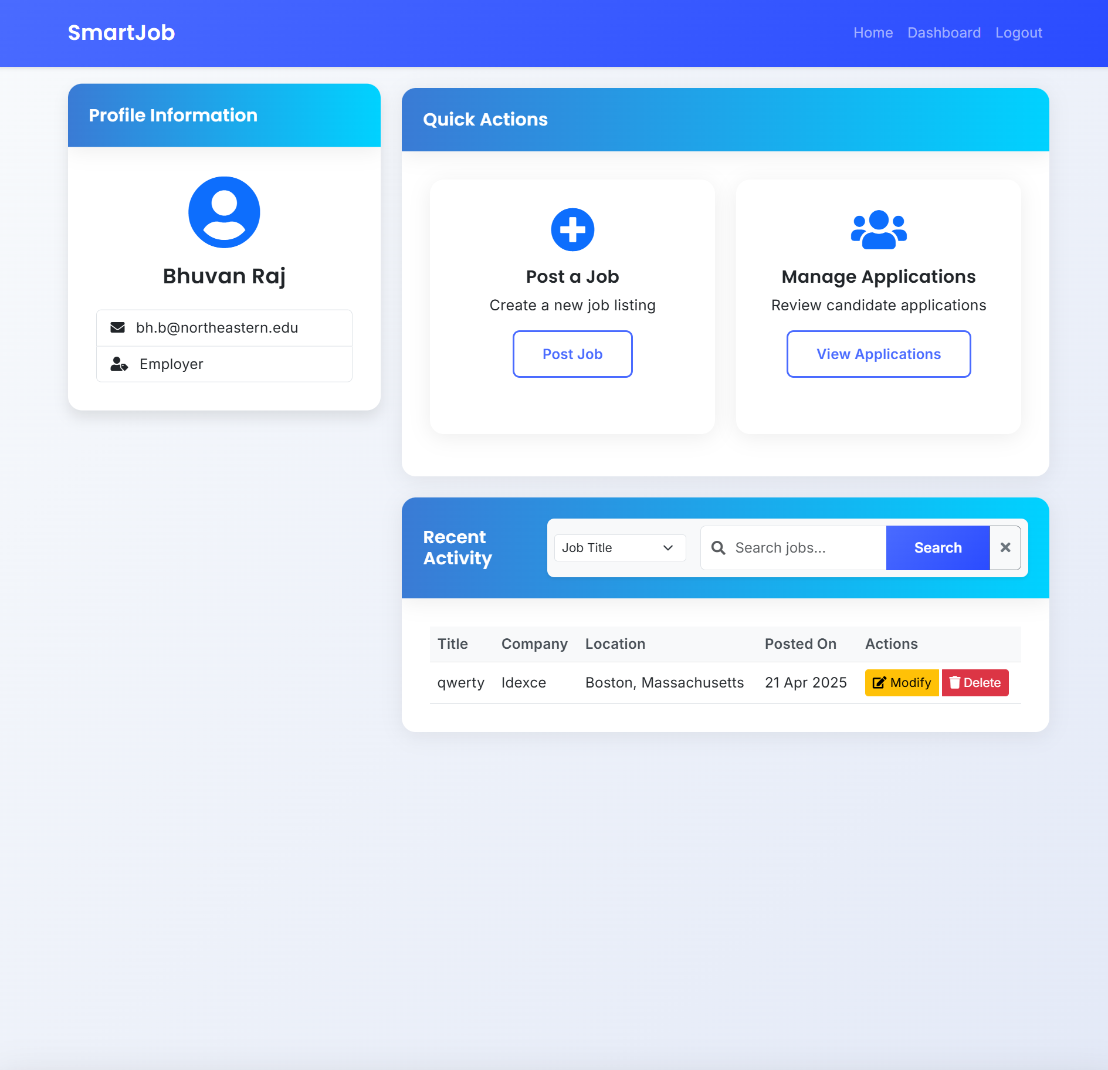
Job Seeker view
Employer view

Slide 4
Architecture & Design Patterns
Design Pattern | Implementation | Purpose/Function
Factory Pattern | • JobPostFactory • UserFactory • SearchStrategyFactory • ApplicationSearchStrategyFactory | Creates objects without specifying exact class, enabling dynamic creation of different job types, user types, and search strategies
Builder Pattern | • JobPostBuilder | Constructs complex JobPost objects with many optional parameters in a step-by-step manner
Command Pattern | • JobPostCommand interface • UpdateJobPostCommand • DeletePostCommand • JobPostInvoker | Encapsulates job post operations as objects, allowing for parameterization and queuing of requests
Strategy Pattern | • SearchStrategy<T> interface • Title/Company/Location strategies • SearchContext<T> | Defines family of interchangeable search algorithms that can be selected at runtime
Observer Pattern | • NotificationObserver • JobSeekerNotificationObserver • NotificationSubject | Implements one-to-many dependency where subjects notify observers automatically of state changes
State Pattern | • ApplicationState interface • Applied/Hired/Rejected/Withdrawn states | Allows job applications to alter behavior based on internal state, with smooth transitions between states
Adapter Pattern | • JobApplicationEmailAdapter | Converts email service interface into appropriate format for job application notifications
Singleton Pattern | • Spring beans (services, repositories) | Ensures single instance of services and repositories throughout the application
Repository Pattern | • JobPostRepository • UserRepository • NotificationRepository | Abstracts data access logic, providing clean separation between domain and data layers
Template Pattern | JobSeekerController ProfileController JobSeekerProfileTemplate | Skeleton structure for all Profile based operations for Job Seekers – allows to view and modify the profile

Slide 5
Individual Contributions
Anuj - Email notifications, Job seeker application hire reject flow
Nilraj - Job post create, read, update, delete service and profile section
Anirudh - login, sign up sign in, dashboard , landing page ui
Rohith, Nilraj - In app notifications
Bhuvan, Nilraj - In app search for job seeker and employer

Slide 6
THANK YOU

